Slide 1

Ultrasonic Animal Repeller

Slide 2
Abstract
An ultrasonic repeller is a device that emits high frequency sound waves to repel pests such as rodents and insects. These sound waves are beyond the range of human hearing, but are highly irritating to pests, making them uncomfortable and driving them away from the area. The purpose of this project is to design and build an ultrasonic repeller that is effective in repelling pests while also being safe for human use.The device is compact, cheap, and it does not cause any pollution unlike the other chemical repellents.

Slide 3
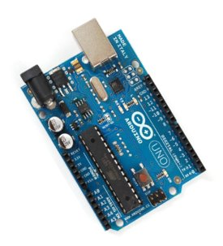
Components
Arduino Uno:
The controlling unit is mainly Arduino UNO. It is a microcontroller board based on the ATMEGA 328p microcontroller. Due to its easily programmable feature and easy-to-use feature, it was the primary choice as a developmental board.
The 14 Digital I/O pins are used to interface various modules with the Arduino. The ultrasonic frequency is generated using Arduino Uno along with a crystal oscillator. The Arduino generates a square wave which is then given to the input of the Power Amplifier. ​

Slide 4
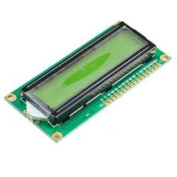
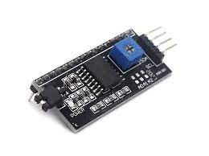
Liquid Crystal Display:
An LCD (Liquid Crystal Display) screen is an electronic display module and has a wide range of applications. A 16x2 LCD display is very basic module and is very commonly used in various devices and circuits. A 16x2 LCD means it can display 16 characters per line and there are 2 such lines. In this LCD each character is displayed in 5x7 pixel matrix. The 16 x 2 intelligent alphanumeric dot matrix display is capable of displaying 224 different characters and symbols. This LCD has two registers, namely, Command and Data.
I2C Module :
I2C_LCD is an easy-to-use display module, It can make display easier. Using it can reduce the difficulty of make, so that makers can focus on the core of the work. We developed the Arduino library for I2C_LCD, user just need a few lines of the code can achieve complex graphics and text display features

Slide 5
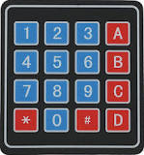
4X4 Keypad :
The 4x4 matrix keypad is a simple mechanism that resembles the numeric input on your computer keyboard, except that it has an additional '*,' '#' and 4 other auxiliary buttons that can be used for various functions in the application.4x4 keypads are widely used in various applications, here are a few examples: Access Control Systems, Security Systems, Data Entry Systems, Industrial Control Systems, Robotics, Electronic projects, etc.
Speaker :
An 8-ohm speaker is a speaker that has a resistance of 8 ohms. This means the speaker can handle a certain amount of power before it damages. A 4-ohm speaker, on the other hand, has a resistance of 4 ohms and can take more energy than an 8-ohm speaker.It is a better idea to go for higher impedance speakers like 8 ohms so that the AVR would not be overburdened

Slide 6
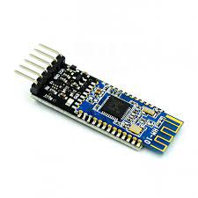
HM – 10 Bluetooth Module :
The HM10 is a serial BLE module (Bluetooth-Low-Energy) which is intended to use for the low power consumption applications and can last long even with a coin-sized battery. The HM10 is a Bluetooth 4.0 module based on the Texas Instruments CC2540 or CC2541 BLE System SoC .The module has a range of 100 m in open space.The HM-10 uses a custom characteristic to send and receive data received through the serial UART interface. It works by setting the value of the custom data value characteristic that is to be transferred. Then it sends the notification to the remote device and says that new data is available

Slide 7
Design and Development
We designed the circuit from referring various research papers . And we are using Arduino Uno as a frequency generating unit and the main controller . at first we thought of only wireless input ,but as we know it's not always reliable hence we added a 4X4 Keypad .
Our main target consumer is farmers , so we included an 16X2 LCD for better visual interpretation , we faced issues with the potentiometer and number of pins has exceeded our expectation , to tackle that we used an I2C module .
As for wireless input , we are using an HM-10 Bluetooth module . We have created a simple application for controlling the module via android mobile phones using MIT App Inventor .

Slide 8
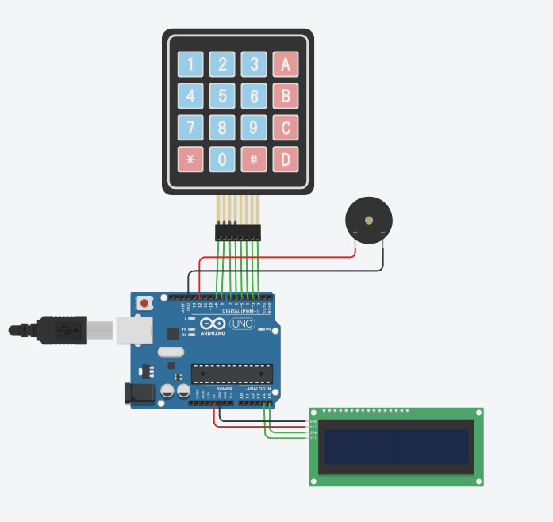
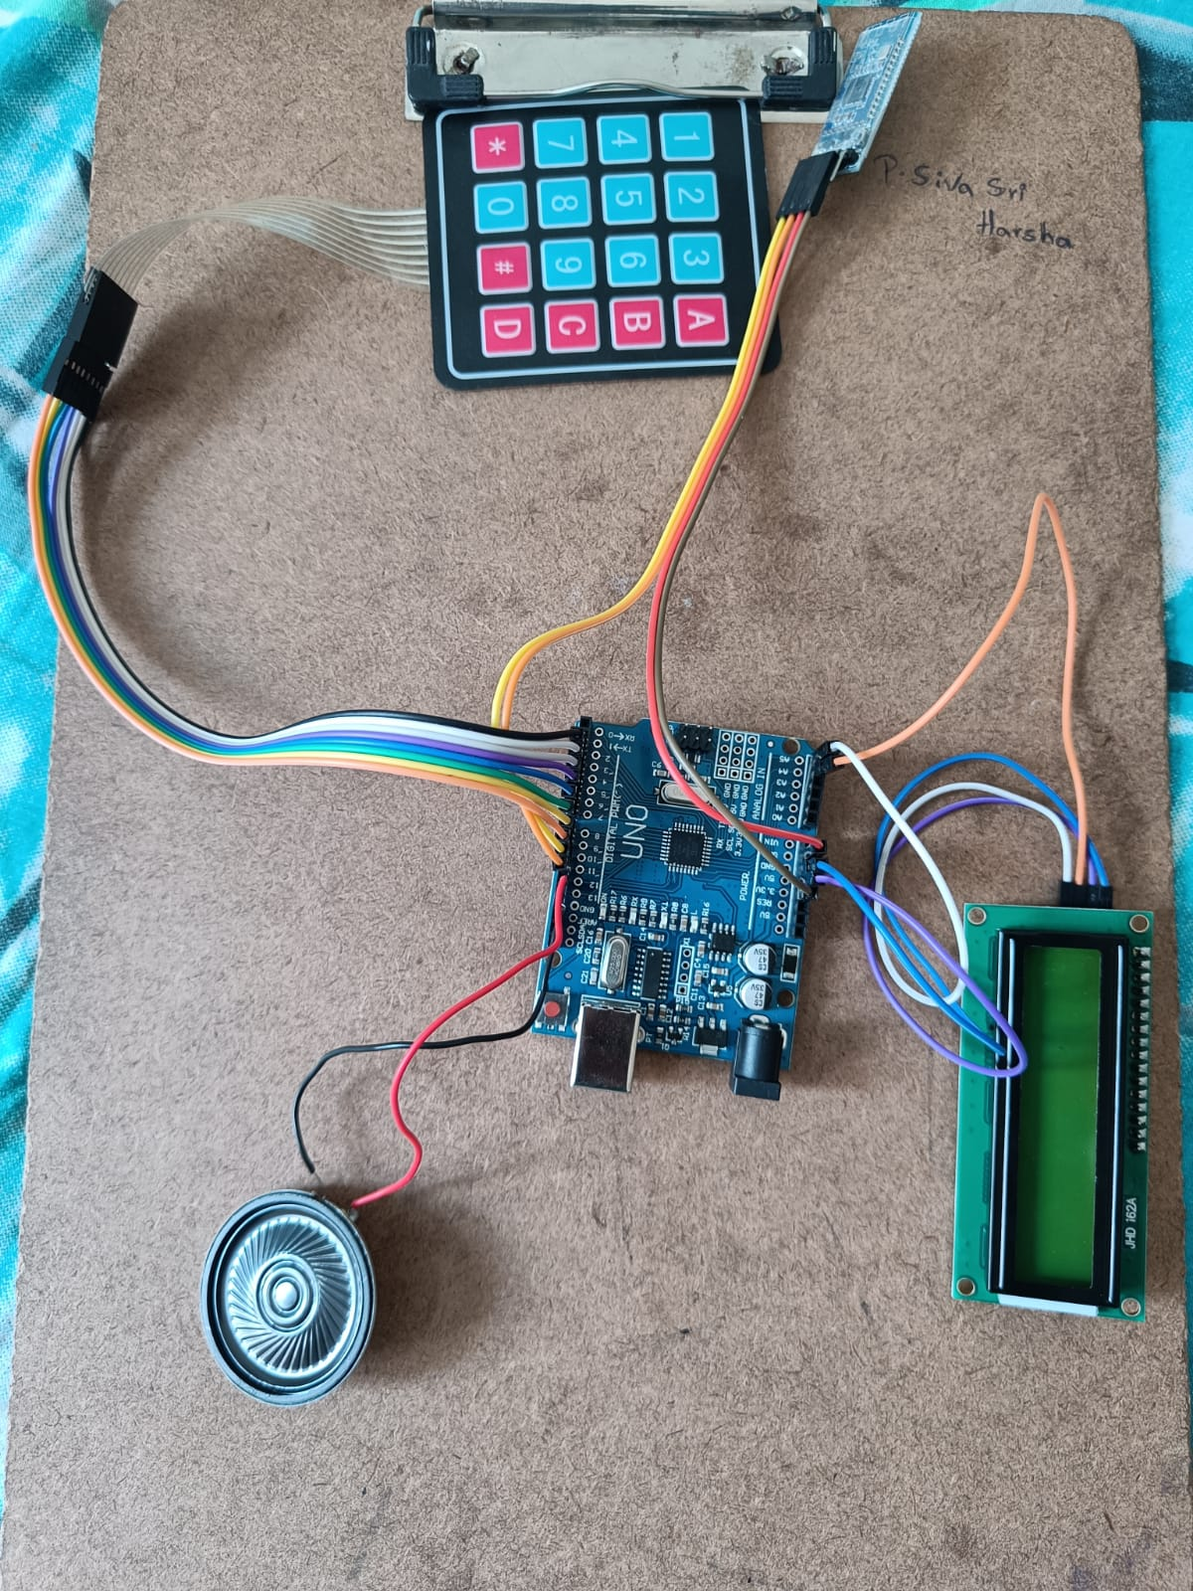
Circuit Diagram

Slide 9
Operation:
The main objective of this research work is to develop a prototype model of a variable frequency ultrasonic pest repeller. It leads to the design and development of an ultrasonic pest repeller where the frequency of emission of ultrasonic sound is continuously varied step-by-step automatically from the range of 25 kHz to 65 kHz. The pest repeller using high-frequency pulsed acoustic waves and electromagnetic waves to attack the nervous system of pests. This system directly attacks the pest's brain and their nervous system, which causes discomfort and change in the behaviour of the pest. This results in the repulsion of the pest from the radiated area. This pest repeller that being design is different from other repellers because this is functioning with multifrequency modulated sounds.The design part of the multi-frequency pest repeller is achieved by the generation of Pulse Width Modulation (PWM) wave frequency.

Slide 10
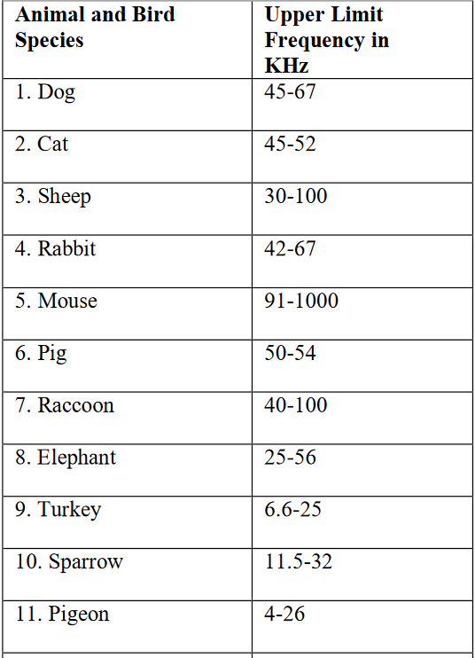
Generally most animal and bugs get repelled starting from 35 KHZ frequency
Here are some upper frequency limits for different animals

Slide 11
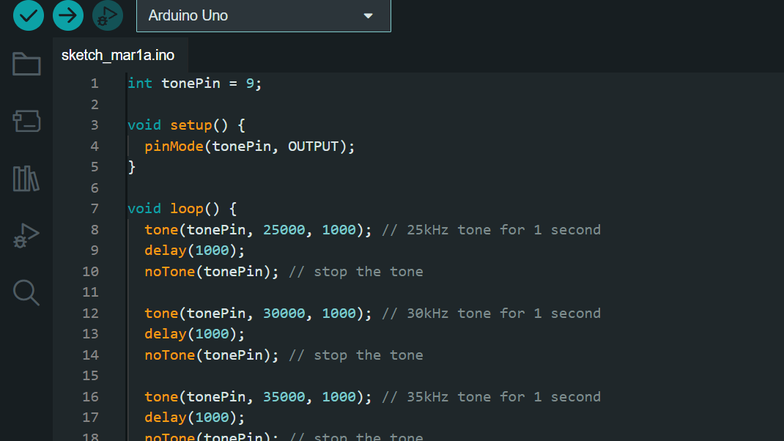
CODE:
Here we use arduino Uno to generate different frequency .the general code to emit a single frequency is as follows

Slide 12
Explanation for the above code
In this code, we first define tonePin as 9, which is the pin that will output the tone. In the setup() function, we set tonePin as an output.
In the loop() function, we first call the tone() function with the arguments tonePin, 1000, and 1000. The first argument is the pin to output the tone, the second argument is the frequency in Hz, and the third argument is the duration in milliseconds. This generates a 1kHz tone for one second.
We then call the delay() function with an argument of 1000, which waits for one second before executing the next line of code. We then call the noTone() function with an argument of tonePin, which stops the tone.
We repeat this process for the 2kHz tone, with a frequency of 2000 Hz and a duration of one second.
You can modify the frequency and duration arguments of the tone() function to generate different frequencies and durations.

Slide 13
Final Code :
#include <Keypad.h>
#include <Wire.h>
#include <LiquidCrystal_I2C.h>
const int speakerPin = 12;
// Define the keypad buttons and their corresponding frequencies
const byte numRows = 4;
const byte numCols = 4;
char keymap[numRows][numCols] = {
{'1', '2', '3','A'},
{'4', '5', '6','B'},
{'7', '8', '9','C'},
{'*', '0', '#','D'}
};
float frequencies[numRows][numCols] = {
{26100.63, 20000, 15000,0.00},
{349.23, 392.00, 440.00,0.00},
{493.88, 523.25, 587.33,0.00},
{0.00, 0.00, 0.00,0.00}
};

Slide 14
// Define the LCD display
LiquidCrystal_I2C lcd(0x27, 16, 2);
// Define the keypad and its pins
byte rowPins[numRows] = {2, 3, 4, 5};
byte colPins[numCols] = {6, 7, 8,9};
Keypad keypad = Keypad(makeKeymap(keymap), rowPins, colPins, numRows, numCols);
void setup() {
pinMode(speakerPin, OUTPUT);
Serial.begin(9600);
lcd.init();
lcd.backlight();
lcd.print("Enter a frequency:");
}
void loop() {
char key = keypad.getKey();
if (key != NO_KEY) {
for (int i = 0; i < numRows; i++) {
for (int j = 0; j < numCols; j++) {
if (keymap[i][j] == key) {
float frequency = frequencies[i][j];

Slide 15
tone(speakerPin, frequency);
lcd.clear();
lcd.setCursor(0, 0);
lcd.print("Frequency:");
lcd.setCursor(0, 1);
lcd.print(frequency);
delay(2000);
noTone(speakerPin);
}
}
}
}
}

Slide 16
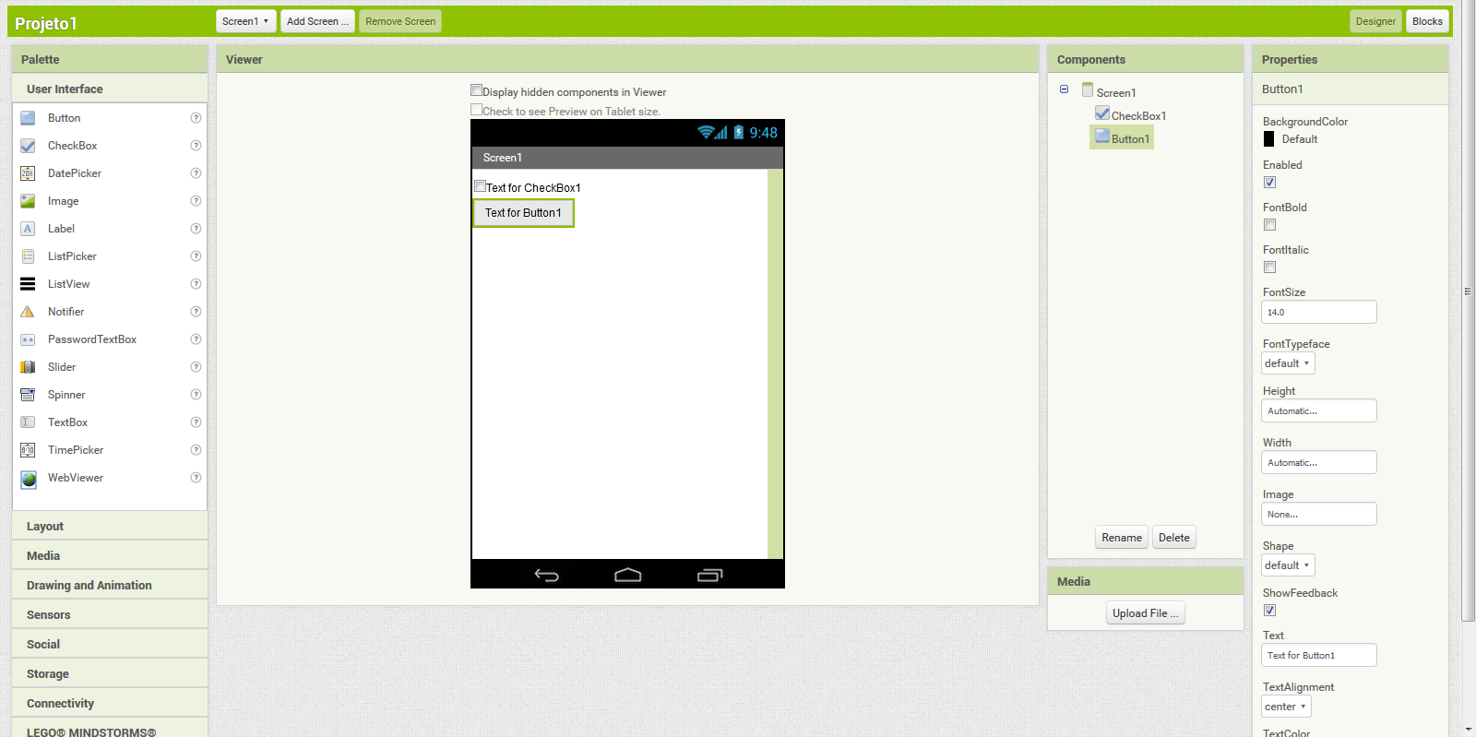
Making an Application for Android :
We used MIT App inventor to make or own custom application , to access
MIT App Inventor is a web application integrated development environment originally provided by Google, and now maintained by the Massachusetts Institute of Technology (MIT). It allows newcomers to computer programming to create application software (apps) for two operating systems (OS): Android and iOS, which, as of 20 January 2023, is in final beta testing. It is free and open-source software .It uses a graphical user interface (GUI) very similar to the programming languages Scratch

Slide 17
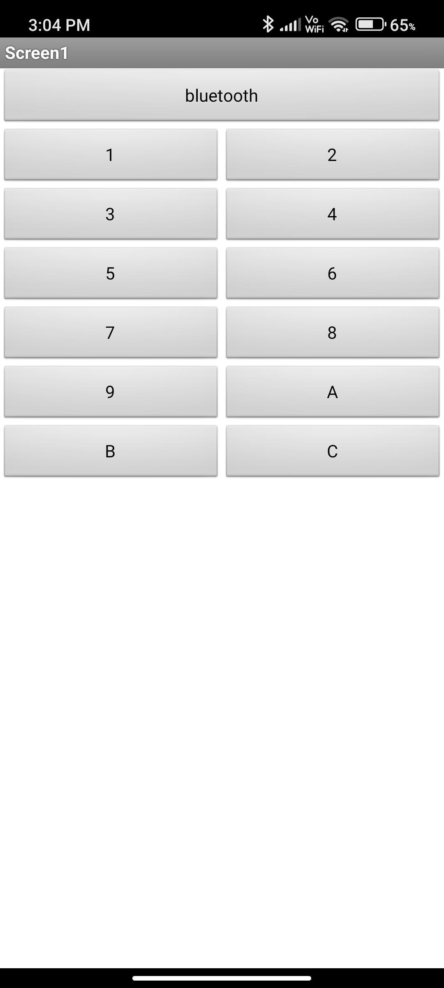
This is the interface of the application we made . It is quite simple and easy to understand for your average person . All you need to do is connect your device to the bluetooth module and now we have access to change the frequency as we desire .

Slide 18
References :
soloar powered smart ultrasonic repellent with dtmf and manual control for agriculture
design and sevelopment of variable frequency ultrasonic repeller
Automatic farmer pest repellent with Arduino ATmega2560 based on
sound displacement technique
electronic pest repeller by eee deparetment iit bombay
smart ultrasonic variable frequency pest repellent by visvakarma institute of tech

Slide 19
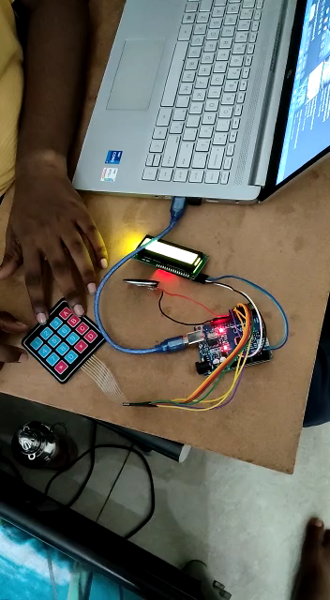
Result:
As ultrasonic frequencies are not audible to we assigned some random frequencies

Slide 20
THANK YOU

